Slide 1



Hotel Reservation
System
Lecturer : Heang sopagna

Slide 2





team member
Ren sodalin
Leng Menghan
kruy seyha
Soeun Sokvipor

Slide 3
Table of Content
01
05
Introduction
09
DDL
view
02
06
User/project requirement
10
Data Dictionaries
funtion and Procedure
03
07
ER Diagram
11
DML
Trigger
04
08
Relational model
12
DQL
conclusion

Slide 4



Introduction
A tool designed to automate bookings, manage room availability, and improve guest services. This system simplifies processes for both hotel staff and customers, improving efficiency and satisfaction.

Slide 5


user / project requirement
What the system manages:
Room Management
Reservation Management
Guest Management
Staff & Admin Management
Payments & Transactions
Customer Reviews & Ratings
Special Requests
Partnerships
User :
Guest
Hotel Administrators

Slide 6

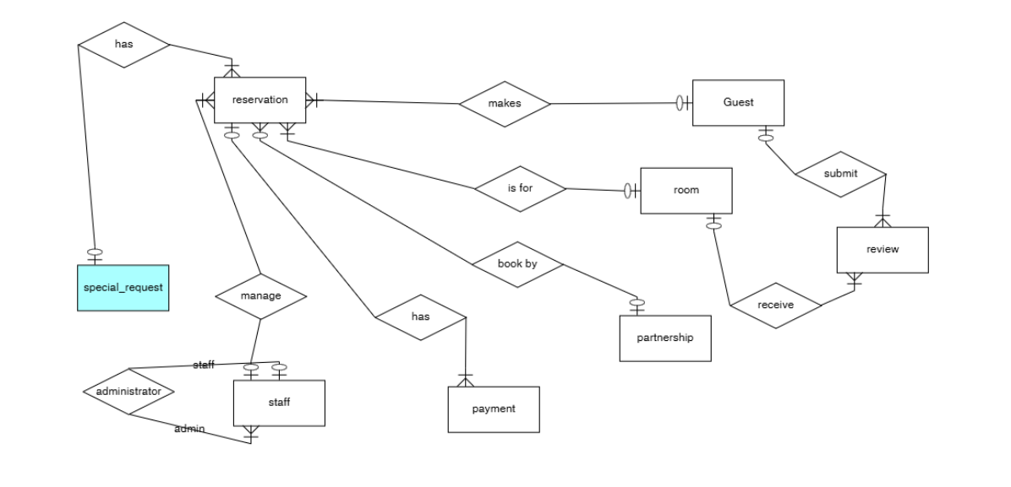
Requirement Analysis
Entity-Relationship Diagram (ERD)

Slide 7

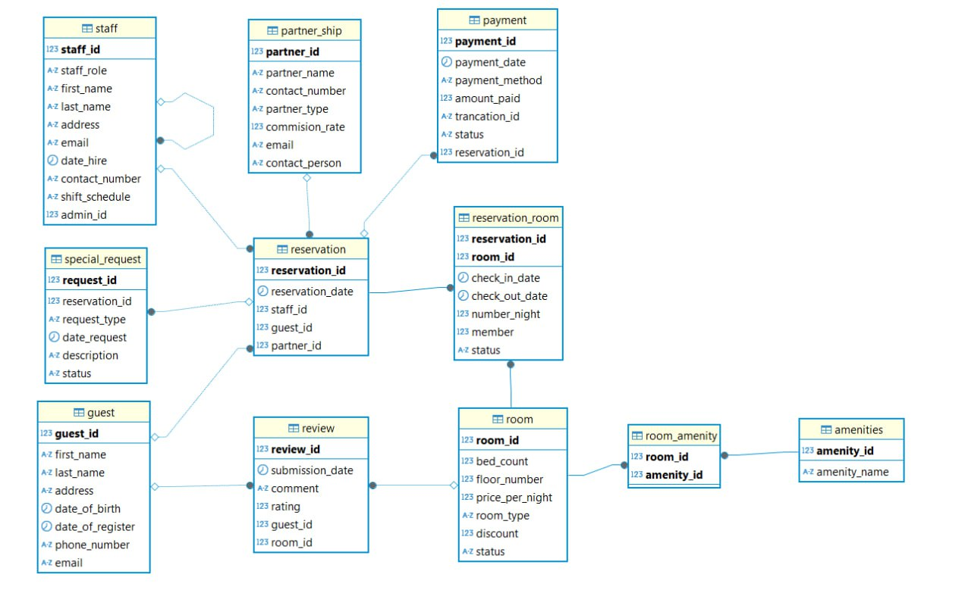
Requirement Analysis
Relational Model ( RM)

Slide 8


DDL (Data Definition Language)
The DDL structure clearly defines how the system manages and organizes data. Relationships are built using primary and foreign keys to maintain referential integrity, ensuring reliable and consistent data across the entire system.

Slide 9
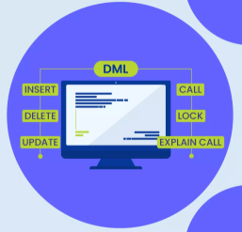

DML (Data Manipulation Language)
Definition: DQL is used to query the database and retrieve data. It consists mainly of the SELECT statement.
Below are key types of queries implemented:
1. Room Availability and Details
2. Guest Management
3. Reservation Insights
4. Reviews and Feedback
5. Staff and Shift Reports
6. Special Requests
7. Partner and Agency Collaboration
8. Payments and Revenue

Slide 10

DQL (Data Query Language)
Views are virtual tables created to simplify data access, enhance reporting, and improve the readability of complex queries.

Slide 11
Stored Procedures & Functions
Stored procedures are used to automate and streamline various operations within the hotel reservation system.
It include :
1.Adding a New Room
2.Updating Room Status
3.Updating Room Status
4.Processing Payments
5.Assigning Rooms to Reservations
6.Adding Special Requests
Refunding Payments

Slide 12
Stored Procedures & Functions
Functions are generally used to return a specific value or calculate results based on input parameters
It include :
1. Calculating Total Reservation Costs
2.Validating Guest Details
3.Checking Room Availability

Slide 13

Triggers
A trigger is a procedural code that is automatically executed in response to certain events on a particular table or view in a database.
Below key is a type of trigger :
1.Update Room Status After Reservation
2.: Log Reservation Deletion
3.Auto-Update Payment Status
4.Track Staff Changes

Slide 14
Data Dictionary
Provides table descriptions, including column names, data types, constraints, and relationships.

Slide 15
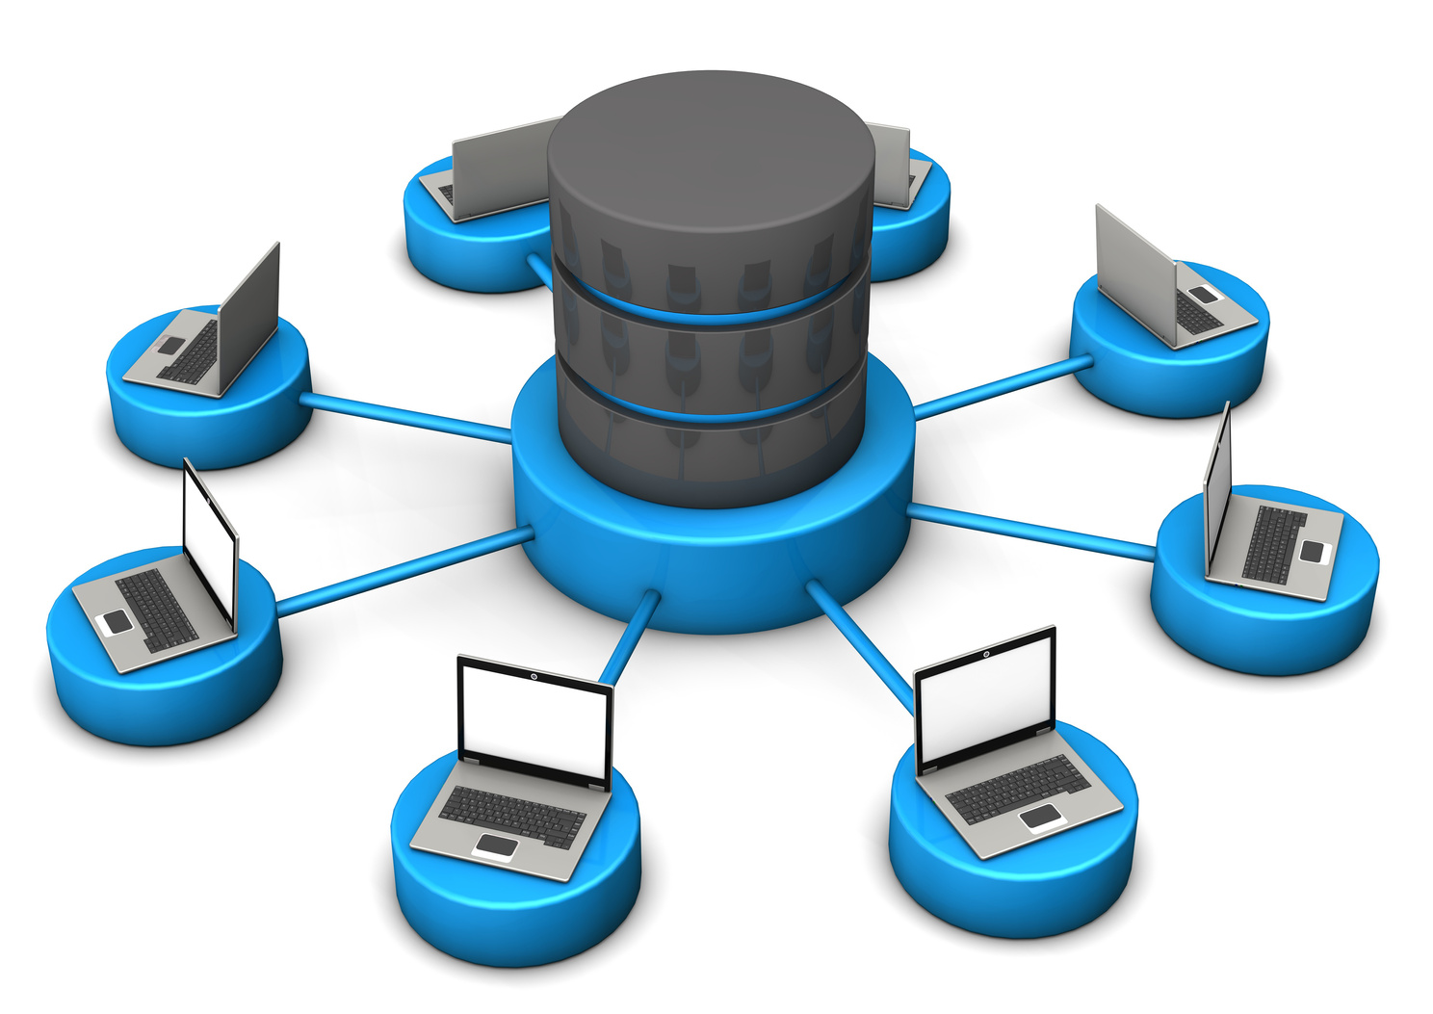
Views
Views are virtual tables created to simplify data access, enhance reporting, and improve the readability of complex queries.
The following views were designed to support hotel management operations:
1. Guest Reservation Summary
2. Room Occupancy
3. Revenue Analysis
4. Staff Performance
5. Room Amenities
6. Partner Performance
7. Upcoming Reservations
8. Guest Reviews

Slide 16


Conclusion & Future Work
Outcome: Successfully implemented database for hotel management.
Strengths & Weaknesses: Discuss system advantages and limitations.
Challenges & Difficulties: Highlight obstacles faced.
Future Work: Possible improvements like AI integration, mobile app expansion, and enhanced security.
Final Thoughts: System enhances hotel operations and guest experience.

Slide 17

Thank You
January 2024

